Slide 1
SQL – Part 2

Slide 2
The select Clause
The select clause list the attributes desired in the result of a query
corresponds to the projection operation of the relational algebra
Example: find the names of all instructors: select name from instructor
NOTE: SQL names are case insensitive (i.e., you may use upper- or lower-case letters.)
E.g. Name ≡ NAME ≡ name
Some people use upper case wherever we use bold font.
Notes:
3

Slide 3
The select Clause (Cont.)
SQL allows duplicates in relations as well as in query results.
To force the elimination of duplicates, insert the keyword distinct after select.
Find the names of all departments with instructor, and remove duplicates
select distinct dept_name from instructor
The keyword all specifies that duplicates not be removed.
select all dept_name from instructor
Notes:
4

Slide 4
The select Clause (Cont.)
An asterisk in the select clause denotes “all attributes”
select * from instructor
The select clause can contain arithmetic expressions involving the operation, +, –, ∗, and /, and operating on constants or attributes of tuples.
The query:
select ID, name, salary/12 from instructor
would return a relation that is the same as the instructor relation, except that the value of the attribute salary is divided by 12.
Notes:
5

Slide 5
The where Clause
The where clause specifies conditions that the result must satisfy
Corresponds to the selection predicate of the relational algebra.
To find all instructors in Comp. Sci. dept with salary > 80000 select name from instructor where dept_name = ‘Comp. Sci.' and salary > 80000
Comparison results can be combined using the logical connectives and, or, and not.
Comparisons can be applied to results of arithmetic expressions.
Notes:
6

Slide 6
The from Clause
The from clause lists the relations involved in the query
Corresponds to the Cartesian product operation of the relational algebra.
Find the Cartesian product instructor X teaches
select ∗ from instructor, teaches
generates every possible instructor – teaches pair, with all attributes from both relations
Cartesian product not very useful directly, but useful combined with where-clause condition (selection operation in relational algebra)
Notes:
8

Slide 7
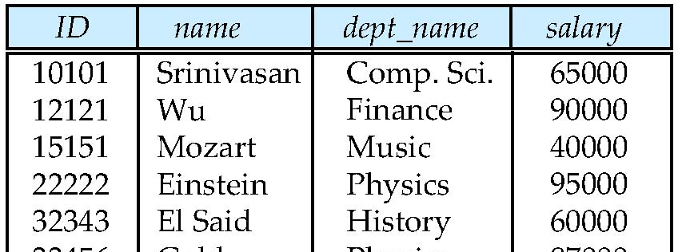
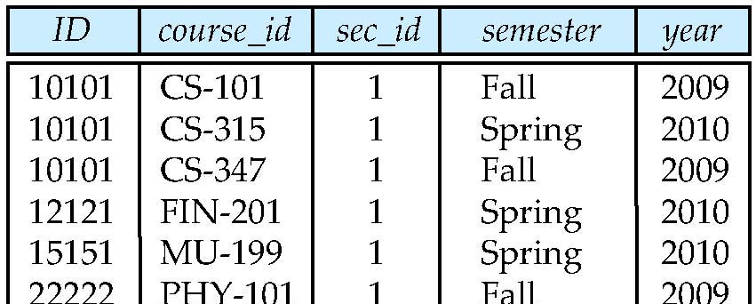
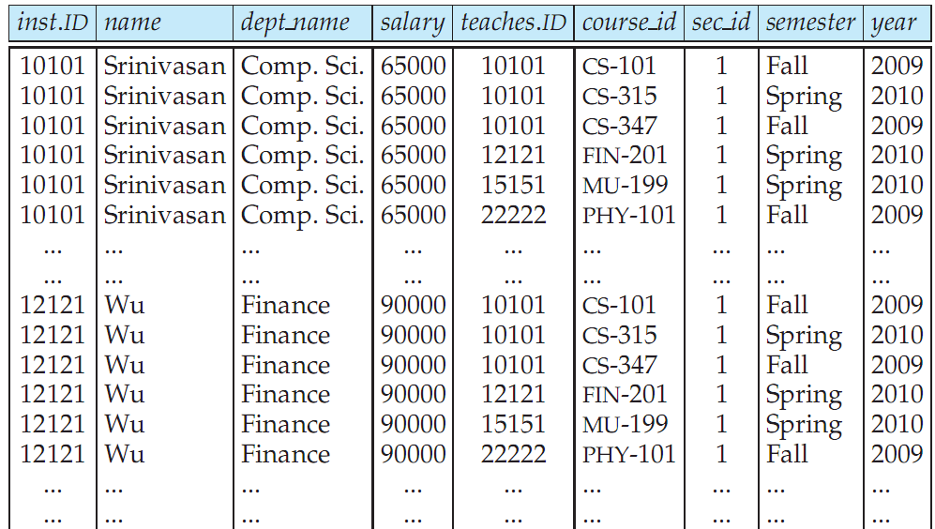
Cartesian Product: instructor X teaches
instructor
teaches

Slide 8
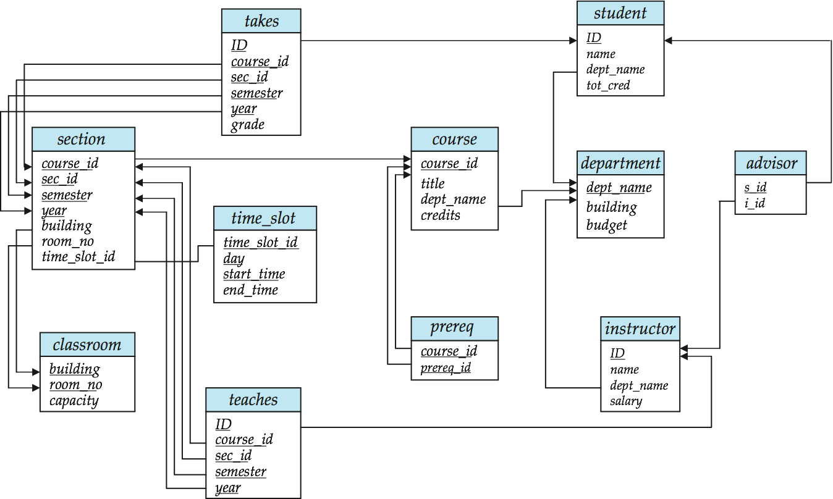
Joins
For all instructors who have taught some course, find their names and the course ID of the courses they taught.
select name, course_id from instructor, teaches where instructor.ID = teaches.ID
Find the course ID, semester, year and title of each course offered by the Comp. Sci. department
select section.course_id, semester, year, title from section, course where section.course_id = course.course_id and dept_name = ‘Comp. Sci.'

Slide 9
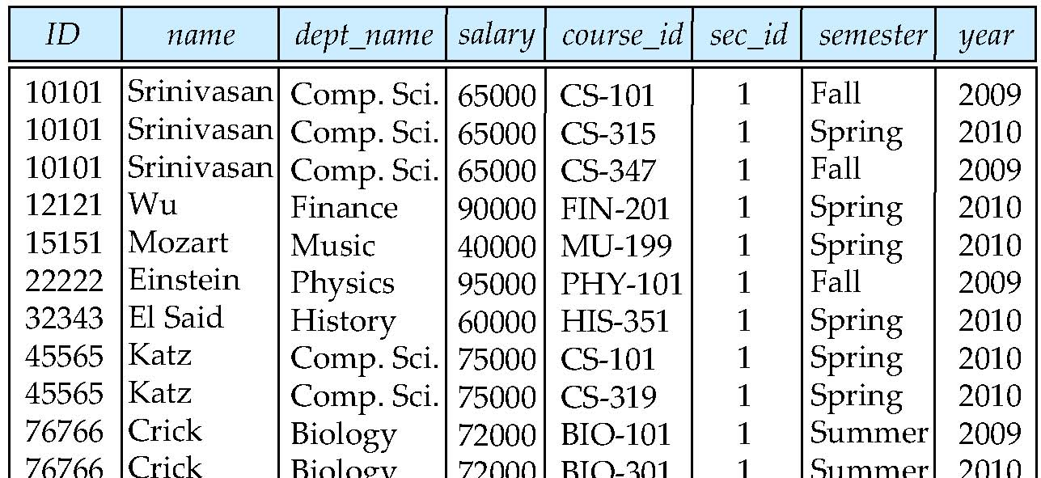
Natural Join
Natural join matches tuples with the same values for all common attributes, and retains only one copy of each common column
select * from instructor natural join teaches;

Slide 10
Natural Join Example
List the names of instructors along with the course ID of the courses that they taught.
select name, course_id from instructor, teaches where instructor.ID = teaches.ID;
select name, course_id from instructor natural join teaches;

Slide 11
The Rename Operation
The SQL allows renaming relations and attributes using the as clause:
old-name as new-name
E.g.
select ID, name, salary/12 as monthly_salary from instructor
Find the names of all instructors who have a higher salary than some instructor in ‘Comp. Sci’.
select distinct T. name from instructor as T, instructor as S where T.salary > S.salary and S.dept_name = ‘Comp. Sci.’
Keyword as is optional and may be omitted instructor as T ≡ instructor T
Keyword as must be omitted in Oracle
Notes:
9

Slide 12
String Operations
SQL includes a string-matching operator for comparisons on character strings. The operator “like” uses patterns that are described using two special characters:
percent (%). The % character matches any substring.
underscore (_). The _ character matches any character.
Find the names of all instructors whose name includes the substring “dar”. select name from instructor where name like '%dar%'
Match the string “100 %”
like ‘100 \%' escape '\'

Slide 13
String Operations (Cont.)
Patters are case sensitive.
Pattern matching examples:
‘Intro%’ matches any string beginning with “Intro”.
‘%Comp%’ matches any string containing “Comp” as a substring.
‘_ _ _’ matches any string of exactly three characters.
‘_ _ _ %’ matches any string of at least three characters.
SQL supports a variety of string operations such as
concatenation (using “||”)
converting from upper to lower case (and vice versa)
finding string length, extracting substrings, etc.

Slide 14
Ordering the Display of Tuples
List in alphabetic order the names of all instructors select distinct name from instructor order by name
We may specify desc for descending order or asc for ascending order, for each attribute; ascending order is the default.
Example: order by name desc
Can sort on multiple attributes
Example: order by dept_name, name

Slide 15
Where Clause Predicates
SQL includes a between comparison operator
Example: Find the names of all instructors with salary between $90,000 and $100,000 (that is, ≥ $90,000 and ≤ $100,000)
select name from instructor where salary between 90000 and 100000
Tuple comparison
select name, course_id from instructor, teaches where (instructor.ID, dept_name) = (teaches.ID, ’Biology’);
Notes:
7

Slide 16
Set Operations
Find courses that ran in Fall 2009 or in Spring 2010
(select course_id from section where sem = ‘Fall’ and year = 2009) union (select course_id from section where sem = ‘Spring’ and year = 2010)
Find courses that ran in Fall 2009 and in Spring 2010
(select course_id from section where sem = ‘Fall’ and year = 2009) intersect (select course_id from section where sem = ‘Spring’ and year = 2010)
Find courses that ran in Fall 2009 but not in Spring 2010
(select course_id from section where sem = ‘Fall’ and year = 2009) except (select course_id from section where sem = ‘Spring’ and year = 2010)

Slide 17
Set Operations
Set operations union, intersect, and except
Each of the above operations automatically eliminates duplicates
To retain all duplicates use the corresponding multiset versions union all, intersect all and except all. Suppose a tuple occurs m times in r and n times in s, then, it occurs:
m + n times in r union all s
min(m,n) times in r intersect all s
max(0, m – n) times in r except all s

Slide 18
Null Values
It is possible for tuples to have a null value, denoted by null, for some of their attributes
null signifies an unknown value or that a value does not exist.
The result of any arithmetic expression involving null is null
Example: 5 + null returns null
The predicate is null can be used to check for null values.
Example: Find all instructors whose salary is null.
select name from instructor where salary is null

Slide 19
Null Values and Three Valued Logic
Any comparison with null returns unknown
Example: 5 < null or null <> null or null = null
Three-valued logic using the truth value unknown:
OR: (unknown or true) = true, (unknown or false) = unknown (unknown or unknown) = unknown
AND: (true and unknown) = unknown, (false and unknown) = false, (unknown and unknown) = unknown
NOT: (not unknown) = unknown
“P is unknown” evaluates to true if predicate P evaluates to unknown
Result of where clause predicate is treated as false if it evaluates to unknown

Slide 20
Aggregate Functions
These functions operate on the multiset of values of a column of a relation, and return a value
avg: average value min: minimum value max: maximum value sum: sum of values count: number of values

Slide 21
Aggregate Functions (Cont.)
Find the average salary of instructors in the Computer Science department
select avg (salary) from instructor where dept_name= ’Comp. Sci.’;
Find the total number of instructors who teach a course in the Spring 2010 semester
select count (distinct ID) from teaches where semester = ’Spring’ and year = 2010
Find the number of tuples in the course relation
select count (*) from course;

Slide 22
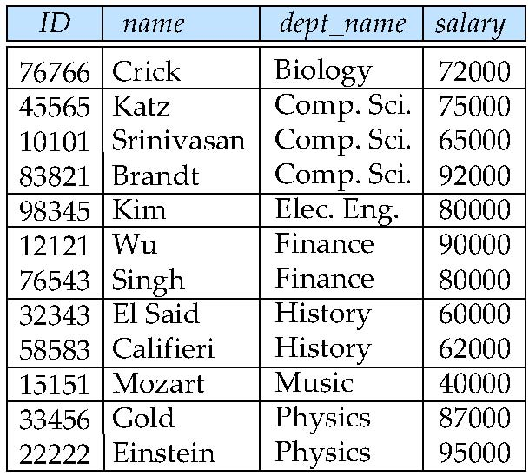
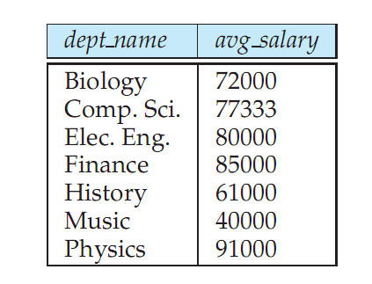
Aggregate Functions – Group By
Find the average salary of instructors in each department
select dept_name, avg (salary) from instructor group by dept_name;
Note: departments with no instructor will not appear in result

Slide 23
Aggregation (Cont.)
Attributes in select clause outside of aggregate functions must appear in group by list
/* erroneous query */ select dept_name, ID, avg (salary) from instructor group by dept_name;

Slide 24
Aggregate Functions – Having Clause
Find the names and average salaries of all departments whose average salary is greater than 42000
select dept_name, avg (salary)
from instructor
group by dept_name
having avg (salary) > 42000;
Note: predicates in the having clause are applied after the formation of groups whereas predicates in the where clause are applied before forming groups

Slide 25
Nested Subqueries
SQL provides a mechanism for the nesting of subqueries.
A subquery is a select-from-where expression that is nested within another query.
A common use of subqueries is to perform tests for set membership, set comparisons, and set cardinality.

Slide 26
Example Query
Find courses offered in Fall 2009 and in Spring 2010
select distinct course_id
from section
where semester = ’Fall’ and year= 2009 and course_id in (select course_id
from section
where semester = ’Spring’ and year= 2010);
Find courses offered in Fall 2009 but not in Spring 2010
select distinct course_id
from section
where semester = ’Fall’ and year= 2009 and course_id not in (select course_id
from section
where semester = ’Spring’ and year= 2010);

Slide 27
Example Query
Find the total number of (distinct) studentswho have taken course sections taught by the instructor with ID 10101
select count (distinct ID)
from takes
where (course_id, sec_id, semester, year) in (select course_id, sec_id, semester, year
from teaches
where teaches.ID= 10101);
Note: Above query can be written in a much simpler manner. The formulation above is simply to illustrate SQL features.

Slide 28
Set Comparison
Find names of instructors with salary greater than that of some (at least one) instructor in the Biology department.
select distinct T.name
from instructor as T, instructor as S
where T.salary > S.salary and S.dept_name = ’Biology’;
Same query using > some clause
select name
from instructor
where salary > some (select salary
from instructor
where dept_name = ’Biology’);

Slide 29
Definition of Some Clause
F <comp> some r ⇔ ∃ t ∈ r such that (F <comp> t ) Where <comp> can be: <, ≤, >, =, ≠
0
(5 < some
5
) = true
(read: 5 < some tuple in the relation)
6
0
(5 < some
5
) = false
0
(5 = some
) = true
5
0
(5 ≠ some
5
) = true (since 0 ≠ 5)
(= some) ≡ in
However, (≠ some) ≡ not in

Slide 30
Example Query
Find the names of all instructors whose salary is greater than the salary of all instructors in the Biology department.
select name
from instructor
where salary > all (select salary
from instructor
where dept_name = ’Biology’);

Slide 31
Definition of all Clause
F <comp> all r ⇔ ∀ t ∈ r (F <comp> t)
0
(5 < all
5
) = false
6
6
(5 < all
) = true
10
4
(5 = all
) = false
5
4
(5 ≠ all
) = true (since 5 ≠ 4 and 5 ≠ 6)
6
(≠ all) ≡ not in
However, (= all) ≡ in

Slide 32
Test for Empty Relations
The exists construct returns the value true if the argument subquery is nonempty.
exists r ⇔ r ≠ Ø
not exists r ⇔ r = Ø

Slide 33
Not Exists
Find all students who have taken all courses offered in the Biology department.
select distinct S.ID, S.name
from student as S
where not exists ( (select course_id
from course
where dept_name = ’Biology’)
except
(select T.course_id
from takes as T
where S.ID = T.ID));
Note that X – Y = Ø ⇔ X ⊆ Y
Note: Cannot write this query using = all and its variants

Slide 34
Test for Absence of Duplicate Tuples
The unique construct tests whether a subquery has any duplicate tuples in its result.
(Evaluates to “true” on an empty set)
Find all courses that were offered at most once in 2009
select T.course_id from course as T where unique (select R.course_id from section as R where T.course_id= R.course_id and R.year = 2009);

Slide 35
Subqueries in the From Clause
SQL allows a subquery expression to be used in the from clause
Find the average instructors’ salaries of those departments where the average salary is greater than $42,000.
select dept_name, avg_salary from (select dept_name, avg (salary) as avg_salary from instructor group by dept_name) where avg_salary > 42000;
Note that we do not need to use the having clause
Another way to write above query
select dept_name, avg_salary from (select dept_name, avg (salary) from instructor group by dept_name) as dept_avg (dept_name, avg_salary) where avg_salary > 42000;

Slide 36
Subqueries in the From Clause (Cont.)
And yet another way to write it: lateral clause
select name, salary, avg_salary from instructor I1, lateral (select avg(salary) as avg_salary from instructor I2 where I2.dept_name= I1.dept_name);
Lateral clause permits later part of the from clause (after the lateral keyword) to access correlation variables from the earlier part.
Note: lateral is part of the SQL standard, but is not supported on many database systems; some databases such as SQL Server offer alternative syntax

Slide 37
Scalar Subquery
Scalar subquery is one which is used where a single value is expected
E.g. select dept_name, (select count(*) from instructor where department.dept_name = instructor.dept_name) as num_instructors from department;
E.g. select name from instructor where salary * 10 > (select budget from department where department.dept_name = instructor.dept_name)
Runtime error if subquery returns more than one result tuple

Slide 38
Joined Relations
Join operations take two relations and return as a result another relation.
A join operation is a Cartesian product which requires that tuples in the two relations match (under some condition). It also specifies the attributes that are present in the result of the join
The join operations are typically used as subquery expressions in the from clause

Slide 39
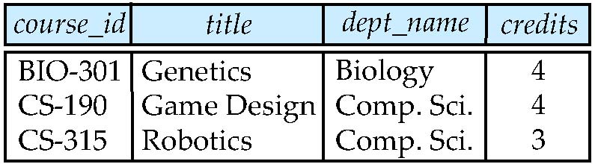
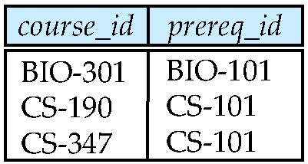
Join operations – Example
Relation course
Relation prereq
Observe that
prereq information is missing for CS-315 and
course information is missing for CS-437

Slide 40
Outer Join
An extension of the join operation that avoids loss of information.
Computes the join and then adds tuples form one relation that does not match tuples in the other relation to the result of the join.
Uses null values.

Slide 41
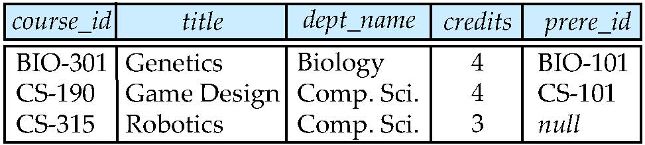
Left Outer Join
course natural left outer join prereq

Slide 42
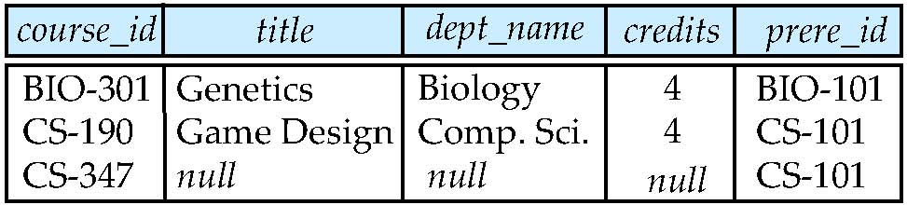
Right Outer Join
course natural right outer join prereq

Slide 43
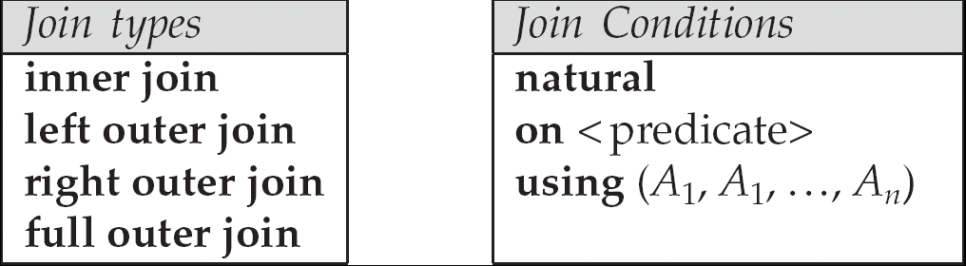
Joined Relations
Join operations take two relations and return as a result another relation.
These additional operations are typically used as subquery expressions in the from clause
Join condition – defines which tuples in the two relations match, and what attributes are present in the result of the join.
Join type – defines how tuples in each relation that do not match any tuple in the other relation (based on the join condition) are treated.

Slide 44
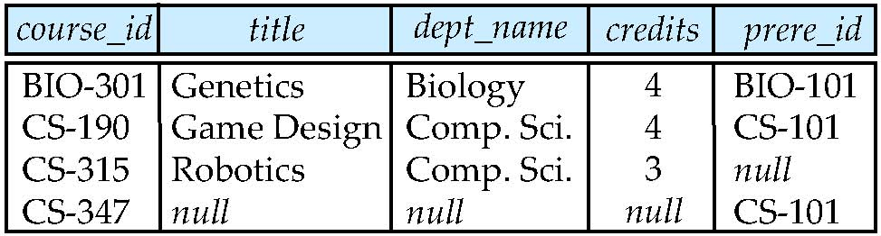
Full Outer Join
course natural full outer join prereq

Slide 45
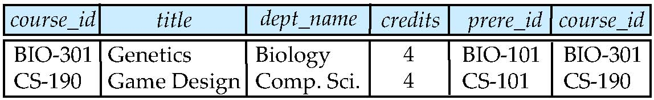
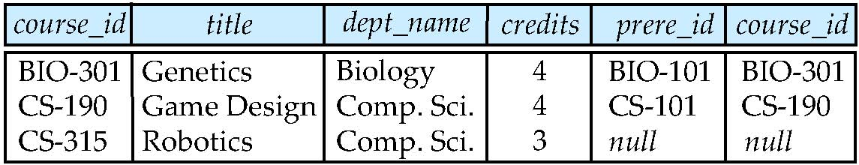
Joined Relations – Examples
course inner join prereq on course.course_id = prereq.course_id
What is the difference between the above, and a natural join?
course left outer join prereq on course.course_id = prereq.course_id

Slide 46
Joined Relations – Examples
course natural right outer join prereq
course full outer join prereq using (course_id)

